Slide 1

AI Based Presentation Slide
Let’s start the journey of AI

Slide 2

Introduction
This presentation provides an insightful overview of Artificial Intelligence (AI), exploring its fundamental concepts, historical advancements, and significant applications. Each section aims to elucidate the vital components of AI, focusing on intelligent agents, problem-solving strategies, and the tools employed in AI development, culminating in a discussion of current challenges and future prospects.

Slide 3


01
Introduction to AI
Artificial Intelligence A Modern Approach
Third Edition
Writter: Stuart J. Russell and Peter Norvig

Slide 4
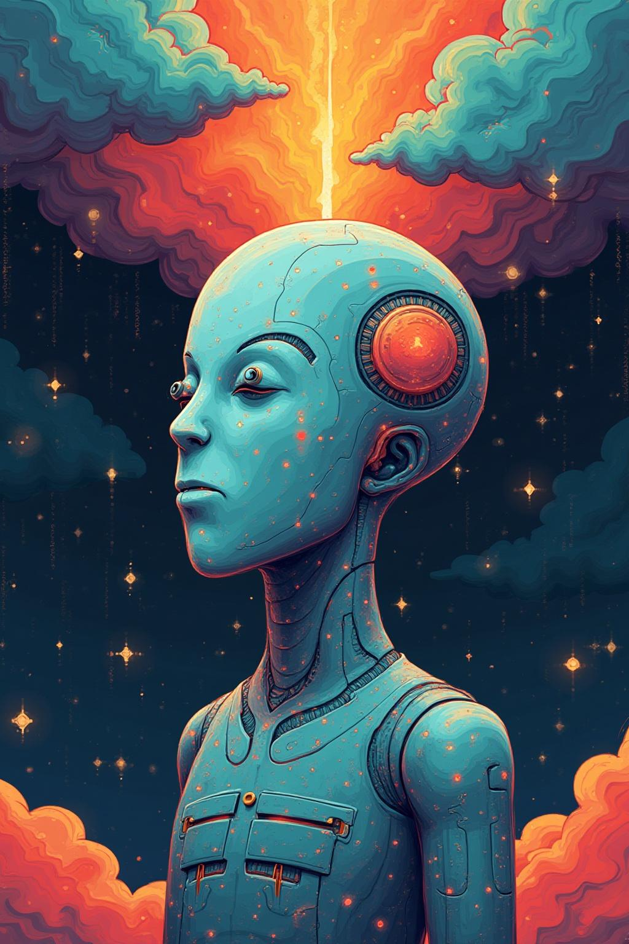
Definition of AI
Artificial Intelligence (AI) is the simulation of human intelligence processes by machines, especially computer systems. These processes include learning, reasoning, and self-correction. AI systems are designed to perform complex tasks that typically require human intelligence, such as understanding natural language, recognizing patterns, and making decisions.

Slide 5
Historical Development
The history of AI dates back to the mid-20th century when pioneers like Alan Turing and John McCarthy laid the groundwork for machine learning and intelligent systems. The development of AI has gone through various phases, including the initial excitement in the 1950s, periods of reduced funding, and recent advancements driven by enhanced computational power, data availability, and sophisticated algorithms.

Slide 6
Applications of AI
Artificial Intelligence is transforming multiple sectors, including healthcare, finance, and transportation. In healthcare, AI aids in diagnosis and personalized medicine. In finance, it enhances risk assessment and fraud detection. Transportation is witnessing advancements in autonomous vehicles and traffic management. AI's ability to analyze vast amounts of data quickly leads to improved decision-making and operational efficiency across various industries.

Slide 7
02
Intelligent Agents

Slide 8
Characteristics of Intelligent Agents
Intelligent agents are systems that perceive their environment and take actions to maximize their chances of success. Key characteristics include autonomy, adaptability, and the ability to act rationally. They can learn from experiences, perform tasks independently, and often utilize reasoning processes to adapt to changing conditions in their operational environment.

Slide 9

Types of Intelligent Agents
Intelligent agents can be classified into various types, including reactive agents, which respond to stimuli from their environment; deliberative agents, which plan actions based on predictions; and hybrid agents that combine both reactive and deliberative strategies. Each type serves different applications, offering tailored solutions based on operational requirements and expected outcomes.

Slide 10
Agent Architectures
Agent architectures define the internal structure of intelligent agents. Common architectures include reactive architectures, which focus on direct responses to environmental stimuli; deliberative architectures, which involve planning and reasoning; and layered architectures that integrate both approaches. Effective architectures are crucial for enabling agents to interact competently with their environments and achieve their goals.

Slide 11
Conclusions
In summary, intelligent agents are pivotal in advancing artificial intelligence. Their distinct characteristics and various types enable them to perform complex tasks across multiple domains effectively. Understanding agent architectures is essential for developing robust AI systems that can learn and adapt to changing conditions, ultimately enhancing productivity and decision-making in numerous applications.

Slide 12
Thank you!
Do you have any questions?
Instructor of this AI Slide : Chironto Rudra Paul

